Slide 1
Auto
Photo
San5se
Hyojoon Kim Minyeong Seo Yundong Lee Soyeon Jung Jihye Choi

Slide 2
Contents
1. Problem
2. Our idea and solution
3. Ways of realization
4. About Auto Photo
5. Target Market

Slide 3
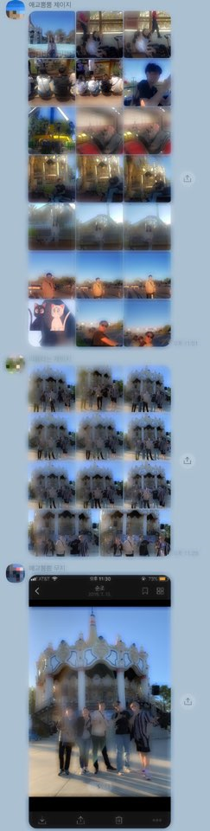
Problem
After taking photos with many friends, the photo taker has to send photos to all individuals in the photo.
→ Too much burden for the photo taker.

Slide 4

Idea and Solution
After taking photos
By using our Application,
App recognizes the faces of the picture and automatically sends the picture to each person.

Slide 5
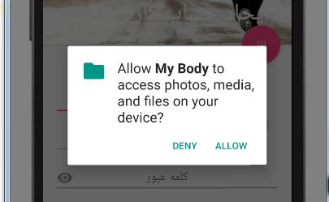
Realization
Access gallery by using API.

Slide 6
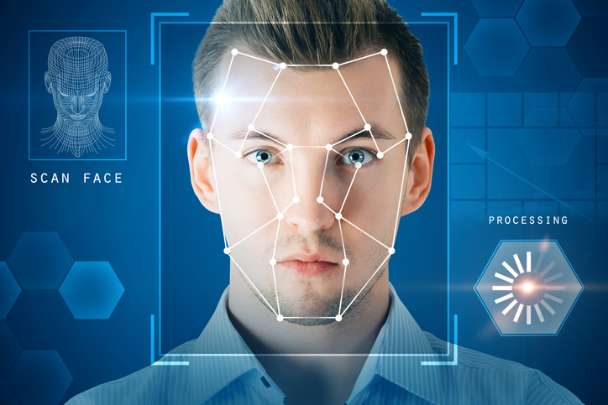
Realization
Face detection by openCV

Slide 7



Realization
Send photo by Bluetooth and by Using Kakao Talk, Snapchat , etc.

Slide 8

Auto Photo
An app that recognizes the face of a person in a picture and automatically sends your photos

Slide 9

Functions
1. Sign up
(KakaoTalk, Snapchat, Instagram, Facebook, Twitter)
2. Main
(Gallery, Set-up, Transmission)
2-1) Gallery
(To access gallery by using API)
2-2) Set-Up
(Upload user’s profile)

Slide 10
Functions
2-3) Transmission
1] Classification of photos through facial recognition
Button ‘Send’
2] After clicking send button
Sharing (Bluetooth, KakaoTalk, snapchat, Instagram, Facebook, Twitter)
3] Finding Users
Send/Cancel

Slide 11
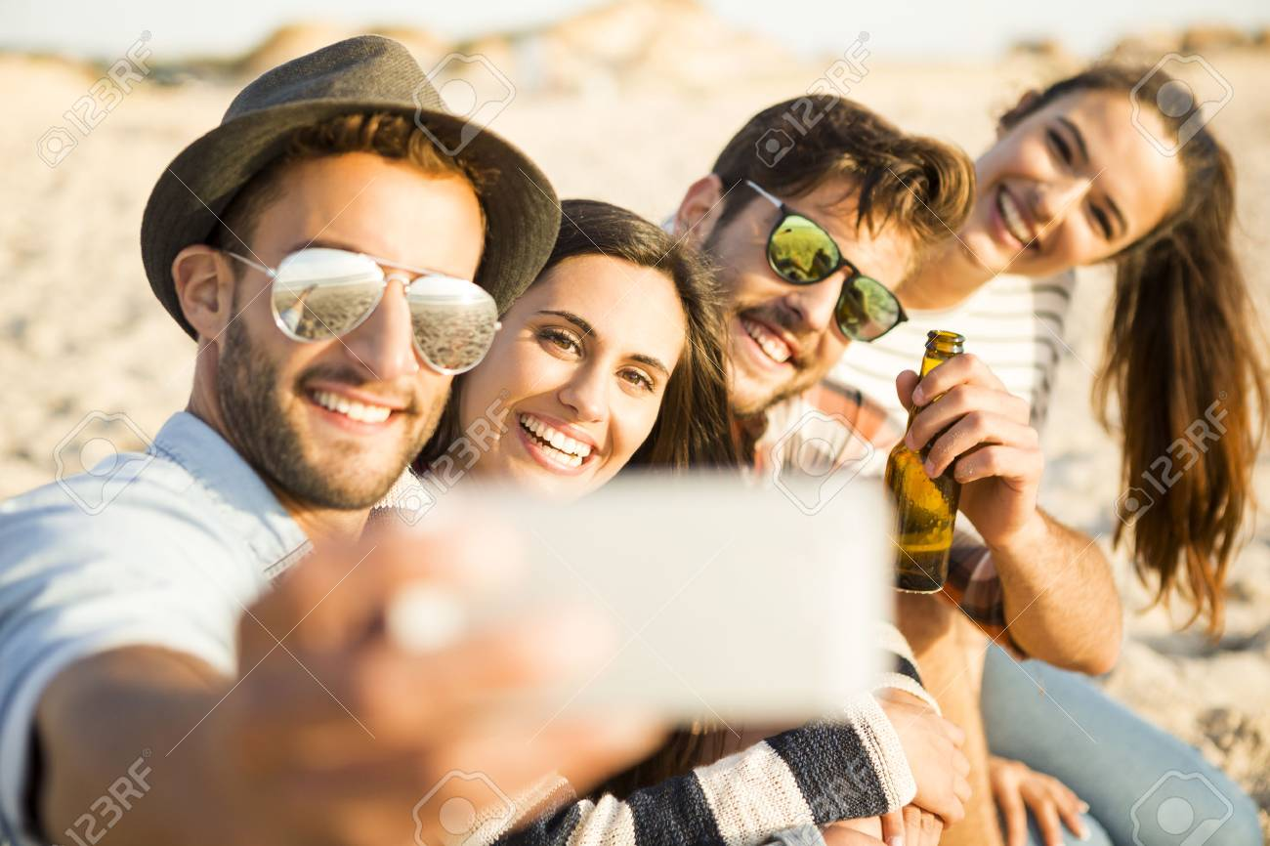
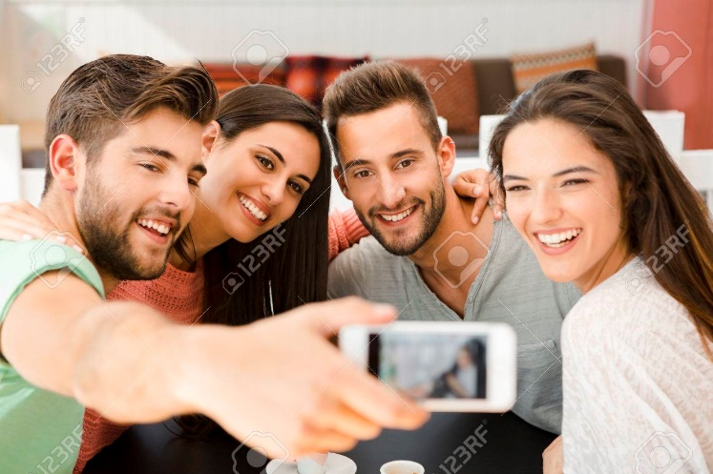
Target Market
Travelers or Anyone who likes to take pictures with friends

Slide 12
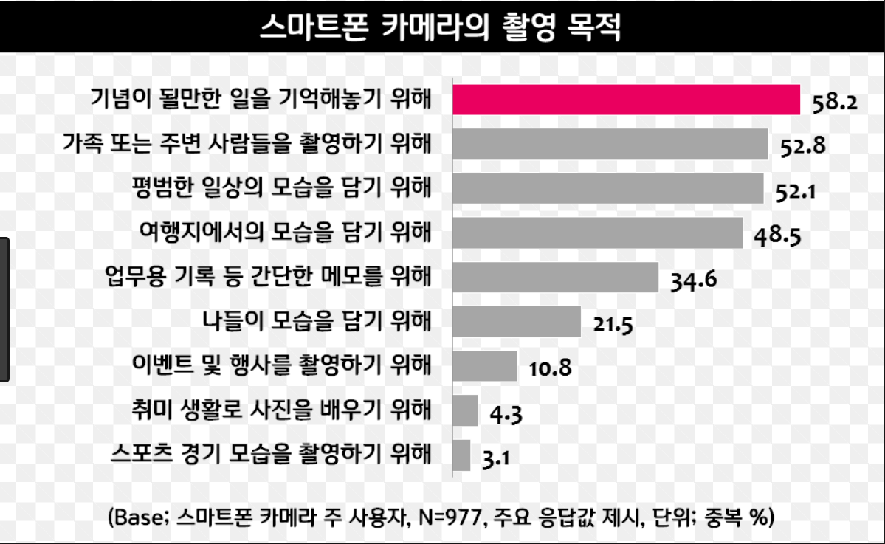
Target Market
Purpose of filming of a smartphone camera
To remember something that would be celebrated
To film the family or people around you.
To capture a normal daily look
To capture the sight of a tourist destination
For brief notes, such as business records.
To capture the outing.
To film events and events
To learn photography as a hobby
To film sports events
Most people use cameras to record precious moments with friends.

Slide 13
Thank
You!

